Slide 1
K-means Clustering ICS635 Homework 2 October 7, 2016
Kim, Song Min
Li, Hualiang
Nishibayashi, Akira

Slide 2
Base model
Dimension = 2
m Gaussian = 4
K (Number of clusters) = 4
σ (Standard Deviation) = 10
δm(X/Y axis distance between m Gaussian) = 100
Number of data in each Gaussian = 1000

Slide 3
Analysis Content
Change input parameters
m Gaussian (1-8)
Standard deviation of Gaussian (1-500)
Distance (X/Y axis) between m Gaussian(10 – 1000)
Number of data in each Gaussian (10 – 10000)
Measure performance (100 times in each case)
Number of iteration on average
Elapsed time to finish 100 times K-means calculations
Notes:
The K-means calculation iterates until there is no change about cluster allocation for all input data points.

Slide 4
Change m Gaussian (1-8)
Example Images:
m, K = 1
m, K = 4 (Base model)
m, K = 8

Slide 5
Change m Gaussian (1-8)
Results:
m Gaussian | 1 | 2 | 4 | 6 | 8
Number of iteration on average | 1.0 | 2.1 | 7.9 | 14.8 | 21.2
Elapsed time (Seconds) | 1.0 | 4.8 | 42.9 | 165.0 | 423.5
Notes:
The data has skewness for upper side. As m Gaussian increase, it takes more time and iteratoin to execute k-means calculation.

Slide 6
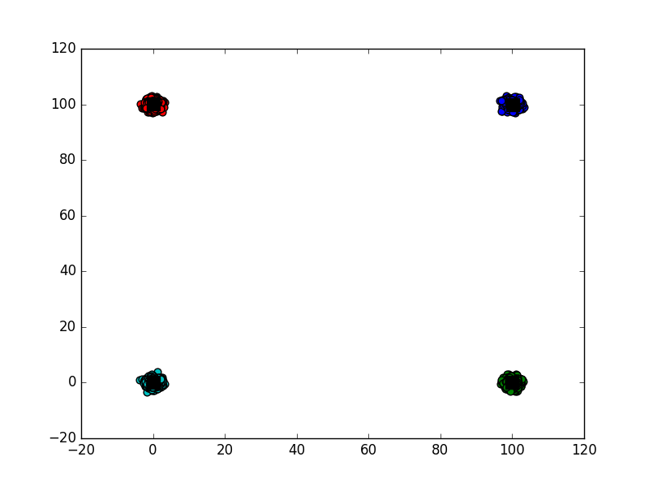
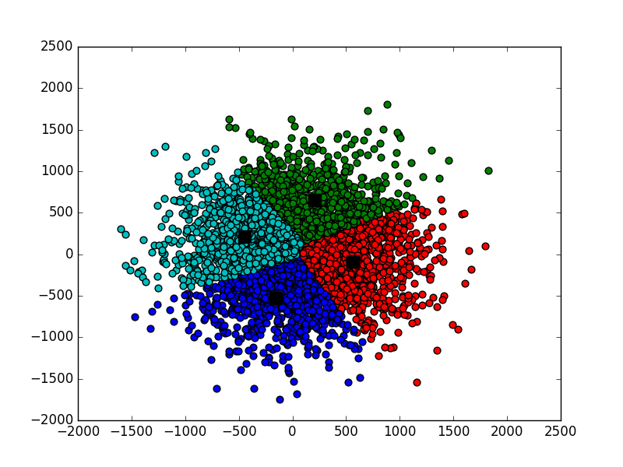
Change standard deviation (1-500)
Example Images:
σ = 10 (Base model)
σ = 500
σ = 1

Slide 7
Change standard deviation (1-500)
Results:
Standard Deviation | 1 | 5 | 10 | 30 | 50 | 80 | 100 | 500
Number of iteration on average | 5.3 | 7.3 | 7.9 | 12.9 | 42.0 | 44.5 | 32.5 | 33.1
Elapsed time (Seconds) | 33.7 | 38.7 | 42.9 | 68.5 | 206.8 | 217.2 | 156.2 | 167.7
Notes:
When σ= 100, 500, the number of iteration does not fit to the trend line. The distance between clusters are 100. So, we guessed that if standard deviation is higher than 100, all clusters become a big one cluster and it is easier to finish K-means calculation than separated clusters.

Slide 8
Change distance (X/Y axis) between m Gaussian (10-1000)
Example Images:
δm = 10
δm = 100 (Base model)
δm = 1000

Slide 9
Change distance (X/Y axis) between m Gaussian (10-1000)
Results:
Distance between m gaussian | 10 | 50 | 100 | 500 | 1000
Number of iteration on average | 31.3 | 7.9 | 7.9 | 2.9 | 2.7
Elapsed time (Seconds) | 154.5 | 49.5 | 42.9 | 20.0 | 18.0

Slide 10
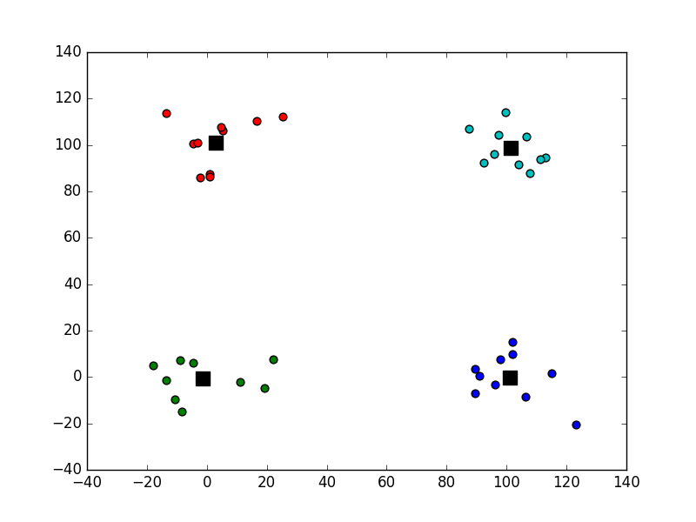
Change number of data in each Gaussian (10-10000)
Example Images:
N = 10
N = 1000 (Base model)
N = 10000

Slide 11
Change number of data in each Gaussian (10-10000)
Results:
Number of data in each gaussian | 10 | 100 | 500 | 1000 | 5000 | 10000
Number of iteration on average | 3.4 | 5.2 | 8.1 | 7.9 | 16.5 | 17.5
Elapsed time (Seconds) | 0.2 | 3.4 | 21.7 | 42.9 | 429.8 | 845.7
Notes:
In this cases, medians in the boxplot and the mean in the chart is

Slide 12
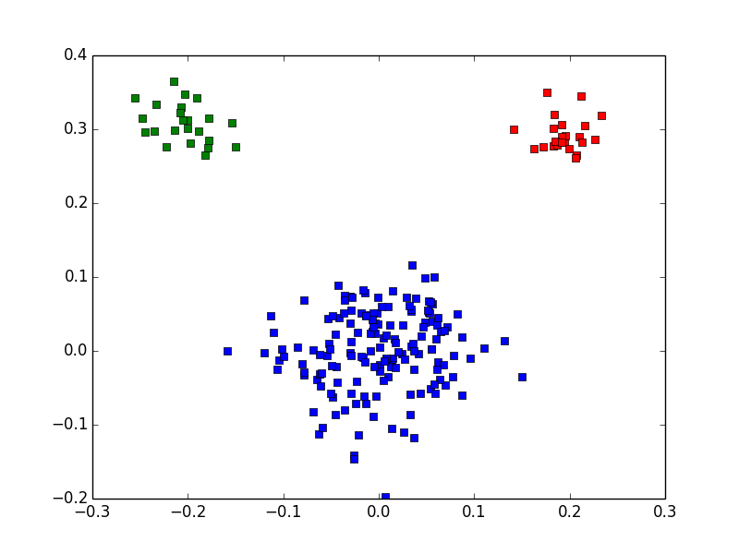
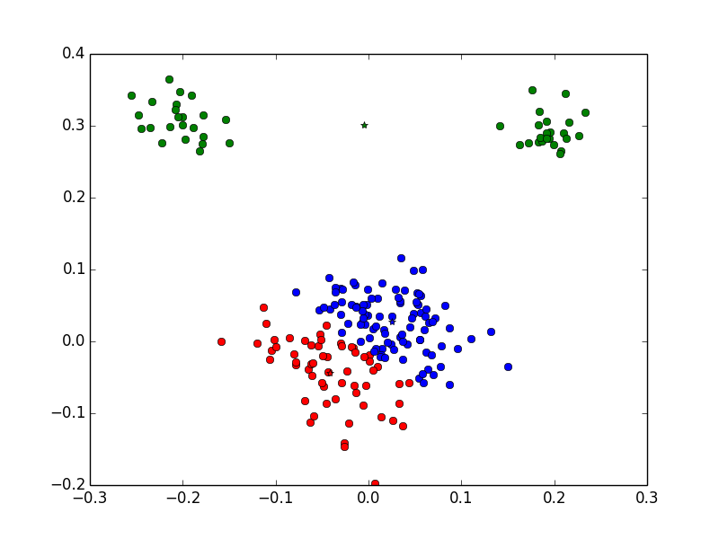
K-mean Failure – cluster structure impact
K-means converge to a local optimum.
Bad result if cluster size has huge different.
Notes:
Even though there is no overlap between different clusters, which is usually considered as a easy classification, the result could be still bad when the cluster size is different. Kmean is expected to generate an equal-size cluster.

Slide 13
K-mean Failure – cluster structure impact
Why that happens?
We randomly pick K points as our initial cluster centroids
P_{i} =
where n_{i} is the size of cluster i,
N is the size of our input data set
For larger n_{i,} P_{i} is larger
Notes:
in probabilistic terms, there is a global solution, but it requires you to iterate over all possible clusterings. Clearly if you have an objective function, the same is true. You could iterate over all solutions and maximize the objective function, but the number of iterations is exponential in the size of your data

Slide 14
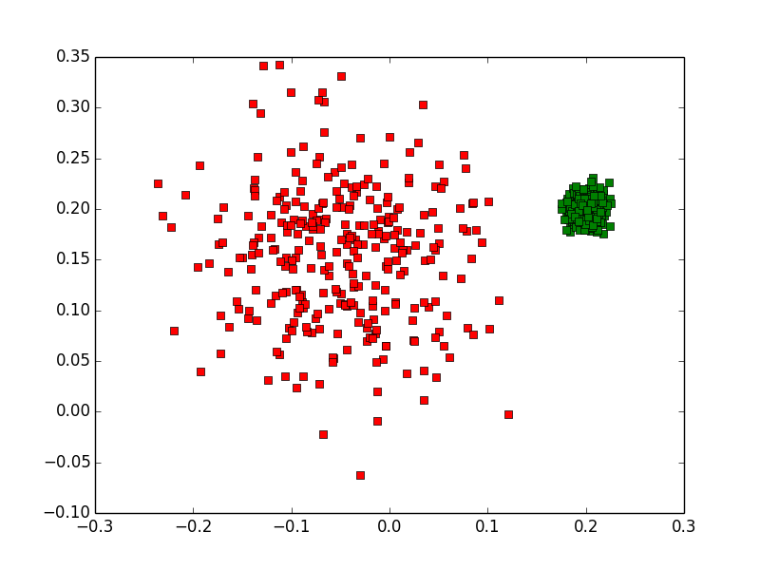
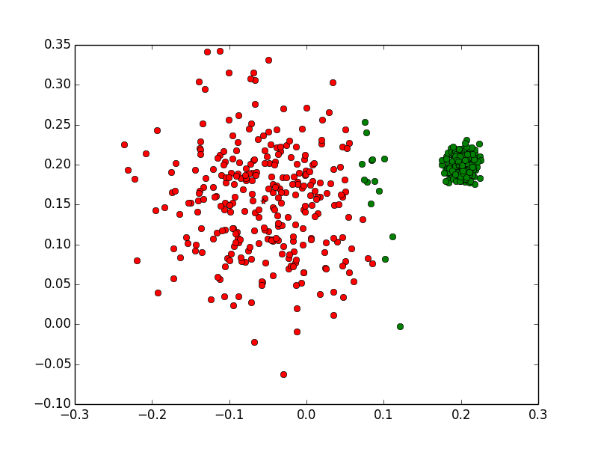
K-mean Failure – cluster structure impact
Even with same size cluster, we could still get bad result
Notes:
In kmean, we treat every points in the data set equally. By “equally”, I mean we assume every points has same weight in terms of how far they are from the cluster center. This is not true, in the example, both of the cluster contains 300 points, but with different variance, which is the sigma in Gaussian distribution.

Slide 15
K-mean Failure – cluster structure impact
Why that happens?
Weight of distance should be
inversely proportional to the deviation
Notes:
The meaning of distance is not fair in some situation. For a cluster that tends to be spreaded-out, the scale of the distance is smaller. Which means, more deviation, the smaller weight the distance should be.

Slide 16
Thank you for listening!

